Slide 1
Spotify ‘23
Top Hits Analysis
Siena, Trang Ft. Omar
Final Presentation

Slide 2
01
Introduction
Top Spotify Songs 2023

Slide 3
Project Goal
Context
Purpose
Audience
Top Spotify Songs 2023
To determine if there is a strong correlation between variables
and the number of streams.
Artists aim to have their songs highly streamed for financial gains, publicity, recognition, and fan base building.
To provide artists with useful information in order to make their
songs more popular/streamable
All artists who are interested in
making it to future Spotify lists.

Slide 4
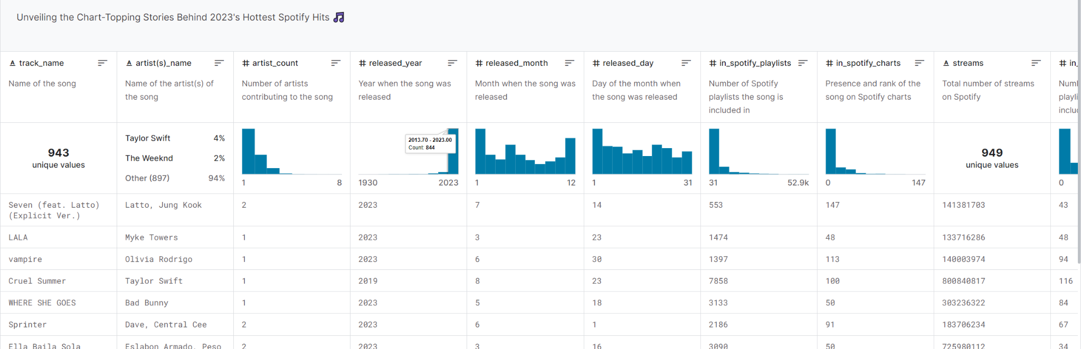
Dataset
Top Spotify Songs 2023
List of top Spotify songs of 2023 - Link.
The dataset includes information about artist(s) name, count, released year, and variables such as danceability, energy, and BPM (Beats per Minute).

Slide 5
Analysis Plan
Top Spotify Songs 2023
Step 1
Step 2
Step 3
Step 4
Load
Prepare
Analyze
Visualize
Use pandas DataFrame
to load the data and focus on streams, danceability, and energy columns.
Convert streams column to a numeric format, and remove all the columns that are not being analyzed.
Run hypothesis tests to check if either energy or danceability affect streams and see if there is a regression relationship between these two variables.
Use seaborn library to visualize the comparison groups in each hypothesis test and the regression relationship between danceability and energy.

Slide 6
02
Analysis
Top Spotify Songs 2023

Slide 7
Research Question 1
Top Spotify Songs 2023
Do songs with high danceability receive a significantly higher number of streams compared to songs with low danceability?

Slide 8
Hypothesis
NULL (H0):
ALTERNATIVE (H1):
Top Spotify Songs 2023
Mean (High Danceability) group <= Mean (Low Danceability) group
Mean (High Danceability) group > Mean (Low Danceability) group

Slide 9
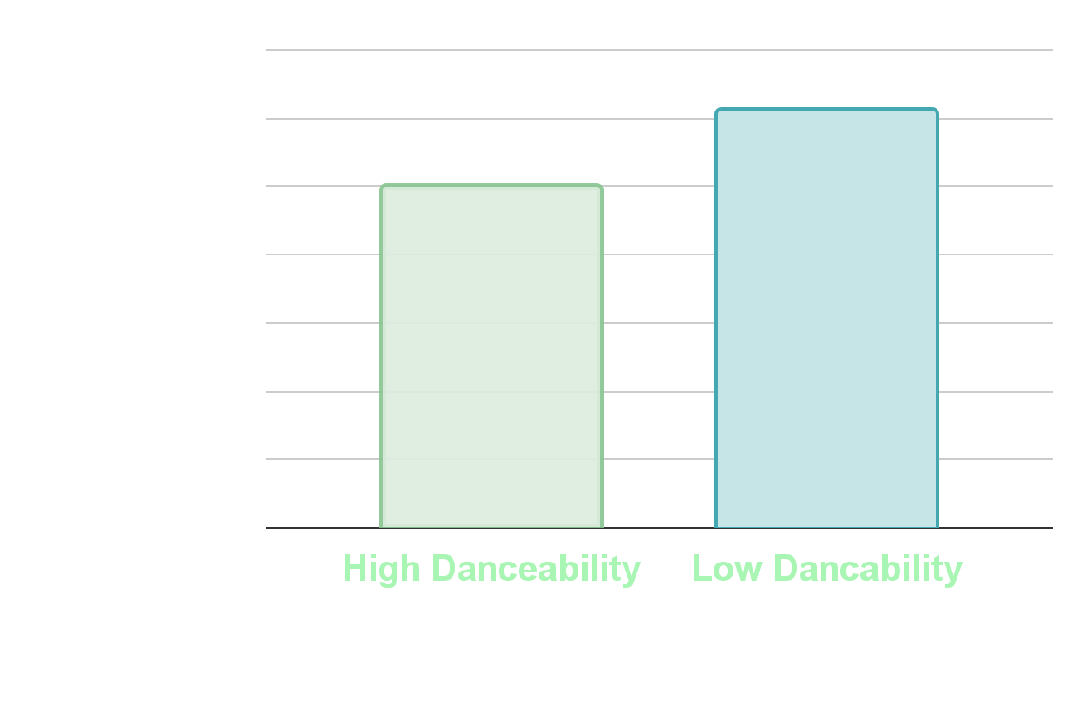
Comparison of Mean Streams by Danceability
Top Spotify Songs 2023
500,303,801
Average High Danceability Streams
611,441,287
Average Low
Danceability Streams
T-statistic: -2.0320684
P-value: 0.04242482816322972
Alpha (Significance Level): 0.05

Slide 10
Conclusion
Top Spotify Songs 2023
Failed to reject H0. There is no higher significance.
Mean(Low Danceability) > Mean(High Danceability).
Therefore: Lower Danceability percentage songs have higher number of streams by far which leads to a higher number of streams on Spotify translating to a higher number on the list of top songs on Spotify 2023.

Slide 11
Research Question 2
Top Spotify Songs 2023
Are more energetic songs associated with a statistically higher number of streams compared to less energetic songs?

Slide 12
Hypothesis
NULL (H0):
ALTERNATIVE (H1):
Top Spotify Songs 2023
Mean (High Energy) group <= Mean (Low Energy) group
Mean (High Energy) group >
Mean (Low Energy) group

Slide 13
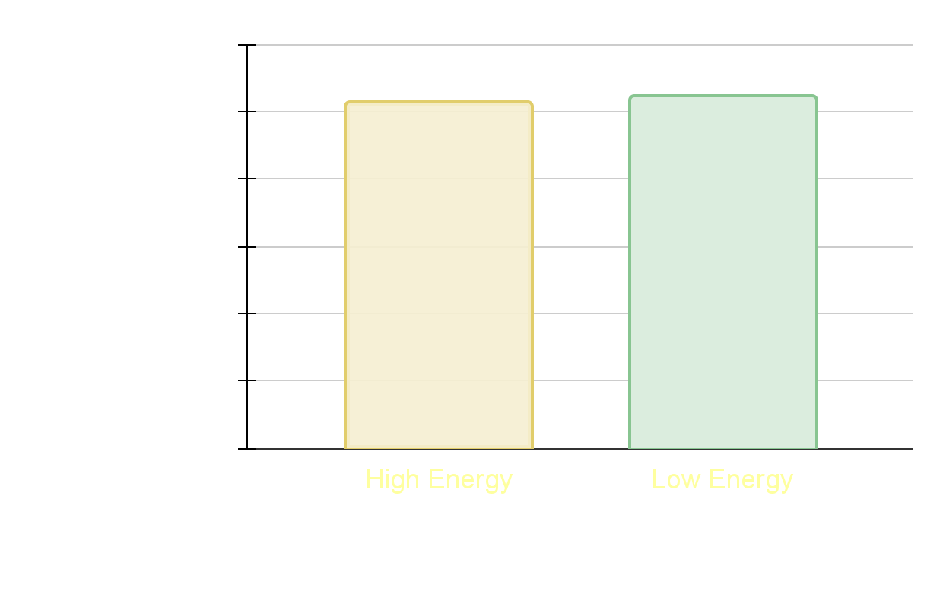
Comparison of Mean Streams by Energy
Top Spotify Songs 2023
513,162,986
Average High
Energy Streams
521,036,352
Average Low
Energy Streams
T-statistic: -0.16874867141
P-value: 0.86603030
Alpha (Significance Level): 0.05

Slide 14
Conclusion
Top Spotify Songs 2023
Failed to reject H0. There is no association.
Mean(Low Energy) > Mean(High Energy).
Therefore: Less energetic songs have higher number of streams by only a little which leads to a higher number of streams on Spotify translating to a higher number on the list of top songs on Spotify 2023.

Slide 15
Research Question 3
Top Spotify Songs 2023
Is there a strong regression relationship between danceability and energy? And what are the details of that relationship?

Slide 16
Hypothesis
NULL (H0):
ALTERNATIVE (H1):
Top Spotify Songs 2023
There is no strong regression relationship between danceability and energy.
There is a strong regression relationship between danceability and energy.

Slide 17
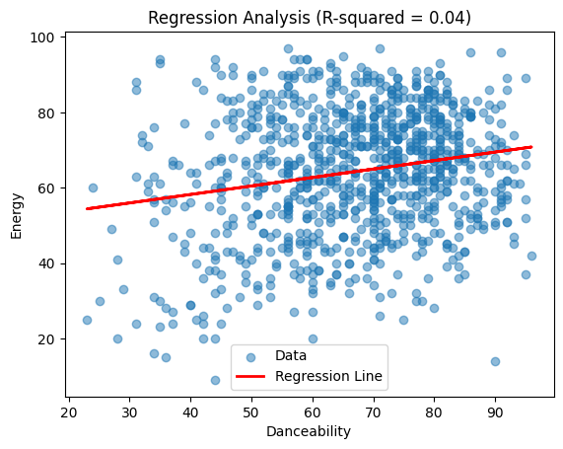
Regression Analysis
Top Spotify Songs 2023
+0.04
R-squared value between energy and danceability
Slope (Coefficient): 0.22
Intercept: 49.20

Slide 18
Conclusion
Top Spotify Songs 2023
Failed to reject H0. There is no strong regression relationship.
A slope (coefficient) of 0.22, which suggests that there is a positive relationship between danceability and energy. Specifically, it implies that for each 1% increase in danceability, the energy increases by 0.22%, on average.
The R-squared value of +0.04 indicates that approximately 4% of the variability in the 'Energy' variable is explained by its relationship with 'Danceability'. While this value is relatively low, it's non-zero, suggesting some level of association.
The analysis suggests a positive but not strong regression relationship between danceability and energy. While both variables are related, danceability alone does not strongly predict the energy of a song.

Slide 19
03
Limitations
Top Spotify Songs 2023

Slide 20

Limitations
Top Spotify Songs 2023
This data set is only from 2023, and trends change frequently.
This dataset is a sample of all songs from around the world in 2023, using Spotify dataset only in the United States.
Artists would need more information than the insights from our analysis to create songs that will achieve high number of streams.

Slide 21
Thank you!
Top Spotify Songs 2023
Questions?

